Slide 1
COTENTS
Introduction
Problem description
Objective
Critical Section
Centralized and decentralized mutual exclusion
Algorithms for mutual exclusion
Comparison of mutual exclusion algorithms
Working
Future scope
Conclusion

Slide 2
INTRODUCTION
If cooperating processes are not synchronized, they may face unexpected timing errors.
Mutual exclusion is a mechanism to avoid data inconsistency. It ensure that only one process (or person) is doing certain things at one time.
Mutual exclusion mechanisms are used to solve Critical Section problems.

Slide 3
Problem description
In operating systems the problem of mutual exclusion is very often encountered because of multiple processes that access, modify certain shared resources such as data structures.
The operating system need to ensure that these shared data structures are not accessed and modified by multiple processes at the same time causing incorrect results for the processes involved.

Slide 4
OBJECTIVE
Comparison of different mutual exclusion algorithms.
Implementation of mutual exclusion problem using an efficient algorithm.

Slide 5
CRITICAL SECTION
Critical Section is a section of code or collection of operations in which only one process may be executing at a given time, which we want to make atomic.
Atomic operations are used to ensure that cooperating processes execute correctly.

Slide 6
The general structure of a typical process Pi is shown in figure below
do {
critical section
remainder section
} while (TRUE);
exit section

Slide 7
Contd..
Requirements for the solution to CS problem
Mutual exclusion – no two processes will simultaneously be inside the same CS
Progress – processes wishing to enter critical section will eventually do so in finite time
Bounded waiting – processes will remain inside its CS for a short time only, without blocking

Slide 8


Centralised and decentralised mutual exclusion
Centralised
Mimic single processor system
One process elected as coordinator
Request resource
Wait for response
Receive grant
access resource
Release resource
request(R)
grant(R)
release(R)

Slide 9
Contd..
If another process claimed resource:
Coordinator does not reply until release
Maintain queue
Service requests in FIFO order
P₂
Queue
request(R)
P₁
C
request(R)
P₂
grant(R)
request(R)
P₀
release(R)
P₁
grant(R)

Slide 10
Contd..
Benefits
Fair
All requests processed in order
Easy to implement, understand, verify
Problems
Process cannot distinguish being blocked from a dead coordinator
Centralized server can be a bottleneck

Slide 11
Decentralized Algorithm
When a process P wants to enter its critical section, it generates a new time stamp, TS, and sends the message request (P,TS) to all other processes in the system.
A process, which receives reply messages from all other processes, can enter its critical section.

Slide 12
Contd..
When a process receives a request message:
if it is in CS, defers its answer.
if it does not want to enter its CS, reply immediately.
if it also wants to enter its CS, it maintains a queue of requests (including its own request) and sends a reply to the request with the minimum time-stamp.

Slide 13
Example
Two processes want to enter the same critical region at the same moment.
Process 0 has the lowest timestamp, so it wins.
When process 0 is done, it sends an OK also; so, 2 can now enter the critical region.
Enters critical region
8
0
0
0
8
OK
OK
8
12
OK
1
2
12
1
2
Enters critical region
12
1
2
OK
(a)
(b)
(c)

Slide 14
ALGORITHMS FOR MUTUAL EXCLUSION
Dekker’s Algorithm:
Dekker’s algorithm is the first known algorithm that solves the mutual exclusion problem in concurrent programming.
It is credited to Th. J. Dekker, a Dutch mathematician. Dekker's algorithm is used in process queuing.

Slide 15
flag[i] = TRUE; /* claim the resource */
while (flag[j]=true) /* wait if the other process is using the { resource */
if (turn == j) /* if waiting for the resource, also wait { our turn */
flag [i] = false; /* but release the resource while waiting
wait until(turn=i)
flag [i] = TRUE;
}
}
//critical section
turn= j; /* pass the turn on, and release the resource */
flag [i] = FALSE;
//remainder section
}
The structure of process A in Dekker's algorithm

Slide 16
Limitations of Dekker’s algorithm
It creates the problem known as lockstep synchronization, in which each thread may only execute in strict synchronization.
It is also non-expandable as it only supports a maximum of two processes for mutual exclusion.

Slide 17
Lamport’s Bakery Algorithm
Lamport’s bakery algorithm is a computing algorithm that ensures efficient use of shared resources in a multithreaded environment.
This algorithm was conceived by Leslie Lamport and was inspired by the first-come-first-served, or first-in-first-out (FIFO).

Slide 18
Lamport’s algorithm
1. Broadcast a timestamped request to all.
2. Request received → enqueue it in local Q. Not in CS → send ack, else postpone sending ack until exit from CS.
3. Enter CS, when
(i) You are at the “head” of your Q
(ii) You have received ack from all
4. To exit from the CS,
(i) Delete the request from your Q, and
(ii) Broadcast a timestamped release
5. When a process receives a release message, it removes the sender from its Q.
Completely connected topology

Slide 19
Peterson’s Algorithm
Peterson's algorithm is a concurrent programming algorithm developed by Gary L. Peterson in a 1981 paper.
Peterson proved the algorithm using both the 2-process case and the N-process case.
It uses only shared memory for communication.

Slide 20
Solutions to the Critical Section Problem through Peterson’s Algorithm:-
Assumption:
1.Assume that a variable (memory location) can only have one value.
2.If processes A and B write a value to the same memory location at the ``same time,'' either the value from A or the value from B will be written rather than some scrambling (means jumbled up) of bits.

Slide 21
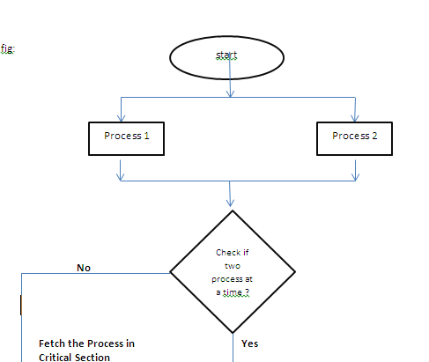
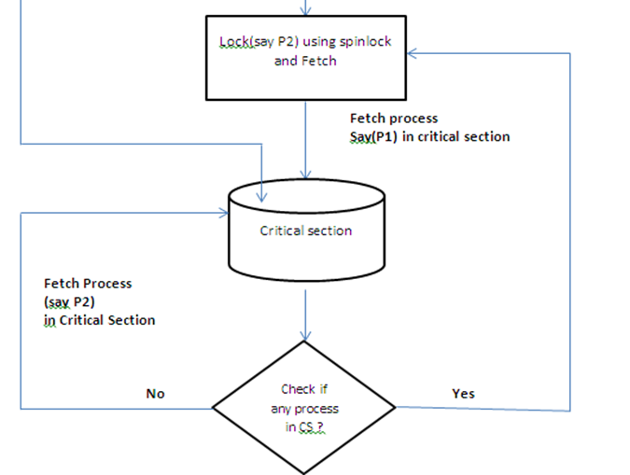
Fig: Two process handling using Peterson’s algorithm

Slide 22
Contd..
Peterson's solution requires the two processes to share two data items:
int turn;
boolean flag[2];
The variable turn indicates whose turn it is to enter its critical section
That is, if turn == i, then process Pi is allowed to execute in its critical section.
The flag array is used to indicate if a process is ready to enter its critical section.
For example, if flag [i] is true, this value indicates that Pi is ready to enter its critical section.

Slide 23
do {
flag [i] = TRUE; /* claim the resource */
turn= j; /* give away the turn */
while (flag[j] && turn== j); /* wait while the other process is using the resource *and* has the turn */
critical section
flag [i] = FALSE; /* release the resource */
remainder section
} while (TRUE);
Figure:-The structure of process A in Peterson's solution.

Slide 24
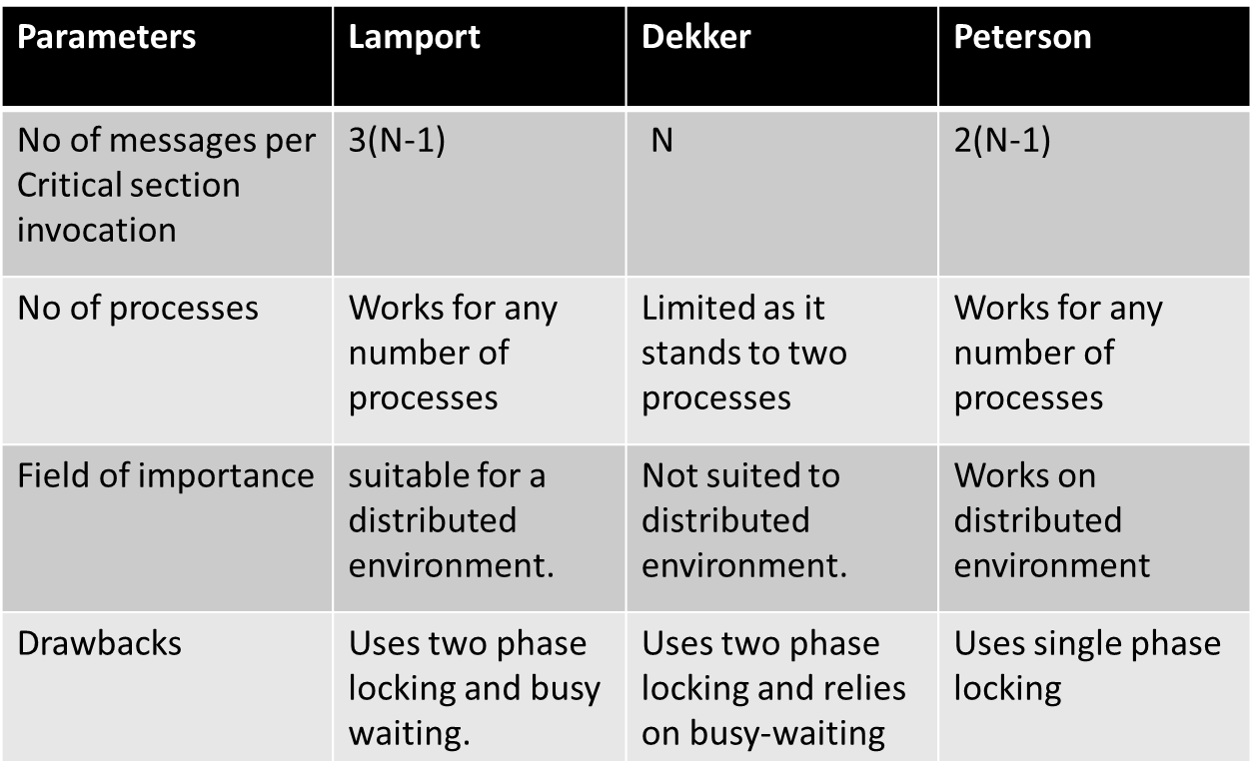
Comparison of Mutual Exclusion Algorithms

Slide 25
Workings
In this implementation we will have two types of improvements:
Time stamped based
Lock based

Slide 26
Time stamped
Here only one process at a time is executing the critical section. The process entering the critical section depends on the counter for each process.
When a counter for a process starts, the particular process enters its critical section and the other processes are blocked till the counter for previous process ends.

Slide 27
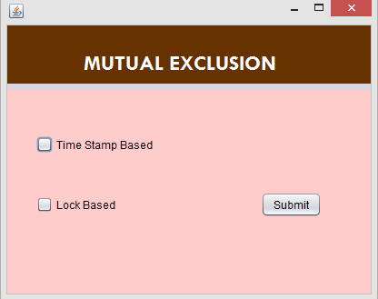
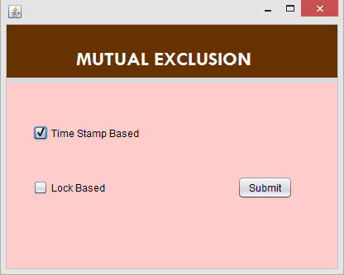
Screenshots

Slide 28
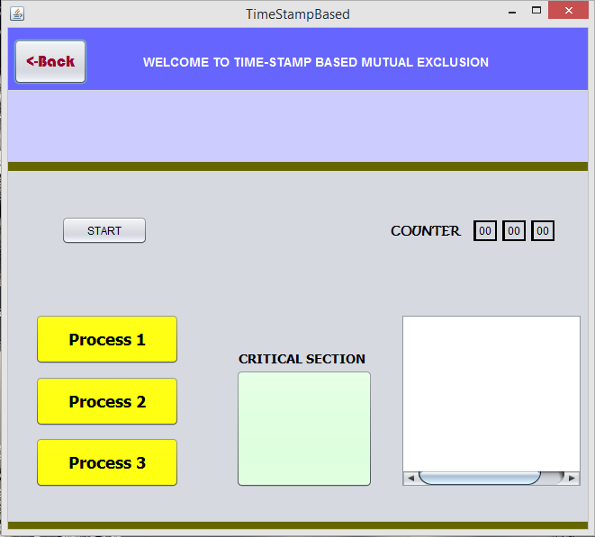
Contd..
Initially no process in critical section

Slide 29
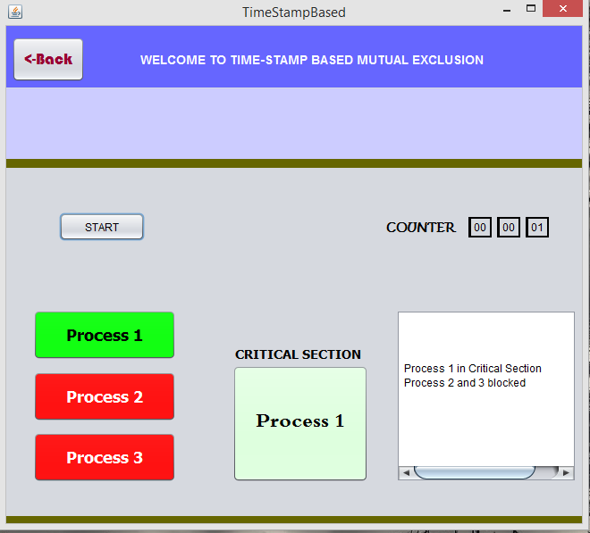
Contd..
At counter 1
Process 1 in CS
Process 2 and 3 blocked

Slide 30
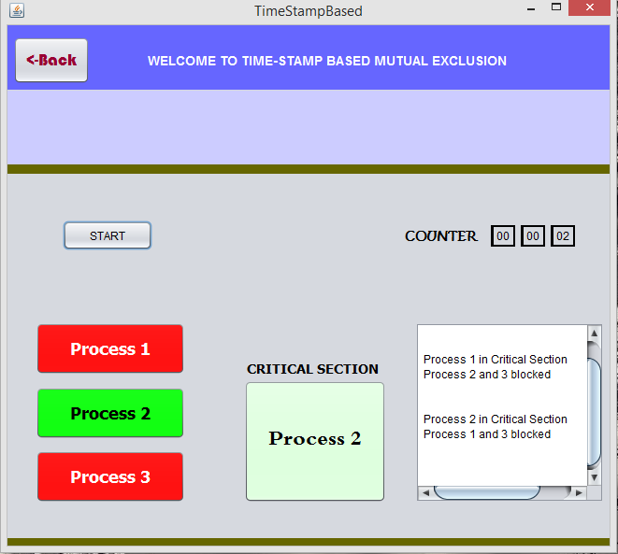
Contd..
At counter 2
Process 2 in CS
Process 1 and 3 blocked

Slide 31
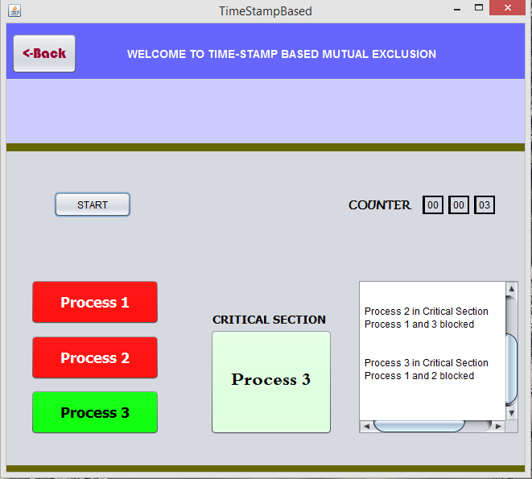
Contd..
At counter 3
Process 3 in CS
1&2 blocked

Slide 32
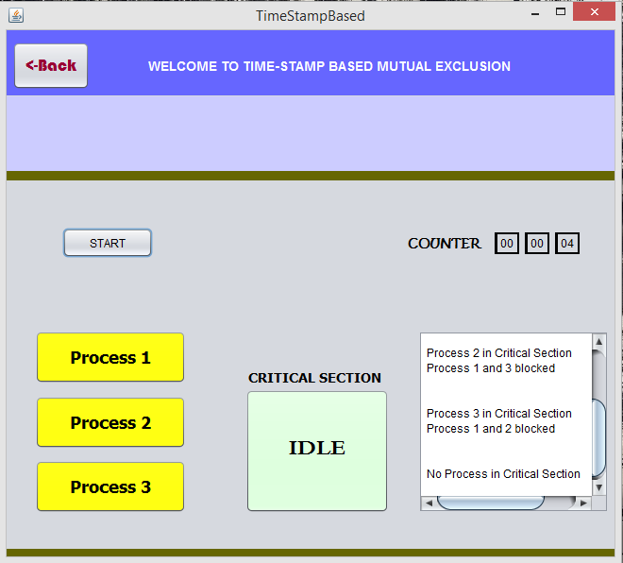
Contd..
At counter 4
Critical section has no process

Slide 33
Lock based Mutual Exclusion
Here two phase locking is used.
Growing Phase (acquire)
Shrinking Phase (release)
All processes are in growing phase but only one is allowed to execute the critical section. Process leaving the critical section goes to shrinking phase.

Slide 34
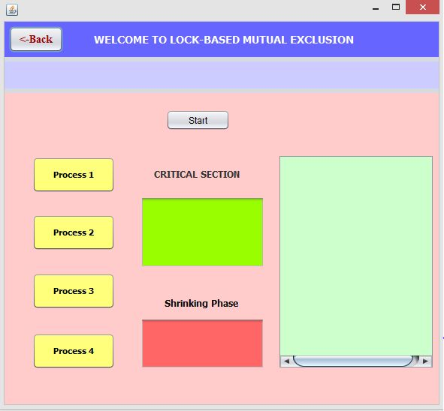
Contd..
No process is executing the critical section

Slide 35
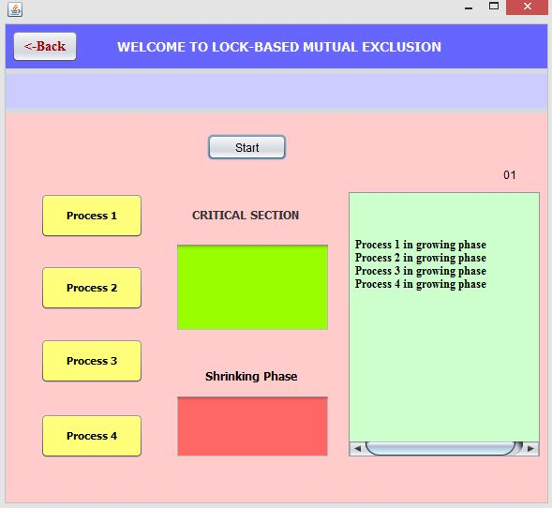
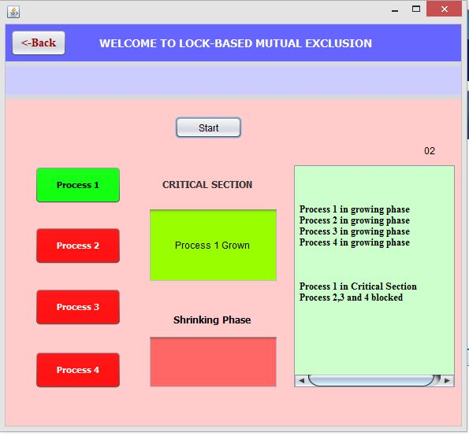
Contd..
At counter 1, all processes in growing phase
At counter 2, process 1 enters the critical section. Process 2,3,4 blocked

Slide 36
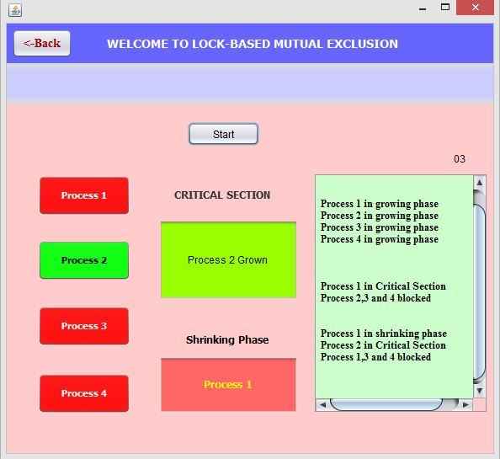
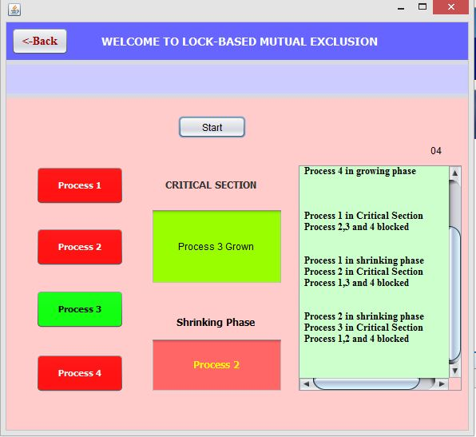
Contd..
At counter 3, process 2 enters CS and process 1 enters shrinking phase
At counter 4, process 3 enters CS and process 2 enters shrinking phase

Slide 37
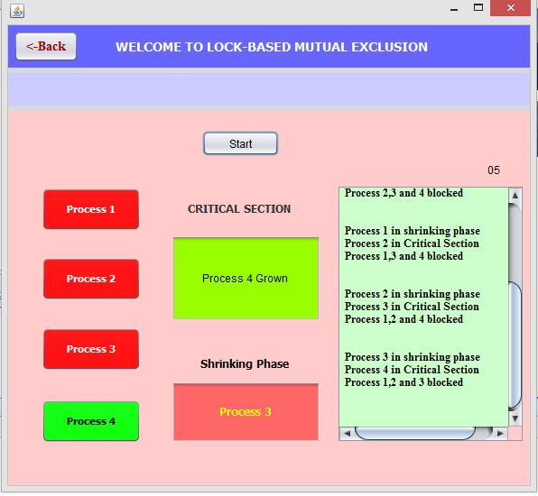
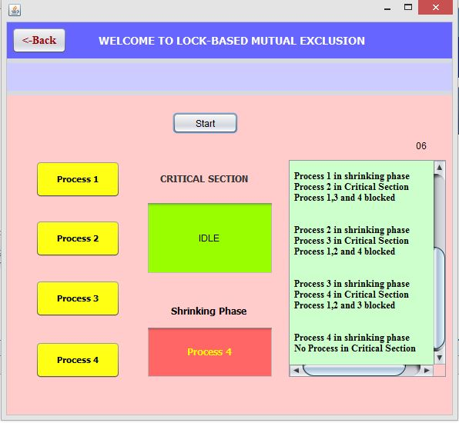
Contd..
At counter 5, process 4 in CS and process 3 enters shrinking phase
At counter 6, CS is idle and process 4 releases the resources

Slide 38
Discussion
In time stamped based, processes enters the critical section when their respective counters are called. Here for a single counter the process does only one work (i.e., executing the critical section)
In locked based approach for a single counter, a process enters the critical section and at the same time enters the shrinking phase so faster execution of process is done without failure.

Slide 39
Future scope
This implementation can be further extended in distributed environment where number of computers can be connected to show how a process access a single resource at a time so that data inconsistency is reduced.
For example- a single process can only write a file but cannot read it.

Slide 40
Conclusion
Concurrent programs are extremely hard to design and notorious for subtle errors. Slips are often possible while characterizing, designing, and proving the properties of concurrent programs.
In this context, precise understanding of the concepts and ideas are extremely important and any misleading interpretations or references about popular algorithms will only add further complexity to the subject matter.

Slide 41
THANK YOU

